Slide 1
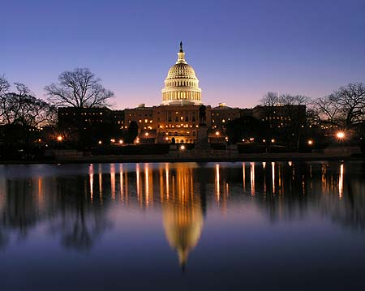
課程主題：美國國會
April 4, 2005:
Dawn at the US Capitol
on a chilly, breezy morning.
Photo Credit: Kevin Ambrose

Slide 2
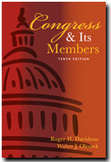
教材
Congress and Its Members
10th ed. 2005
by Roger H. Davidson
and Walter J. Oleszek
Washington: CQ Press.

Slide 3
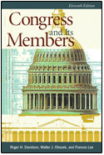
Congress and Its Members,
11th Edition
Date: August 2007
by Roger H. Davidson,
Walter J. Oleszek, and
Frances E. Lee
Washington: CQ Press.

Slide 4
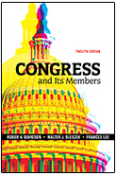
Congress and Its Members,
12th Edition
Date: July 2009
by Roger H. Davidson,
Walter J. Oleszek, and
Frances E. Lee
Washington: CQ Press.

Slide 5
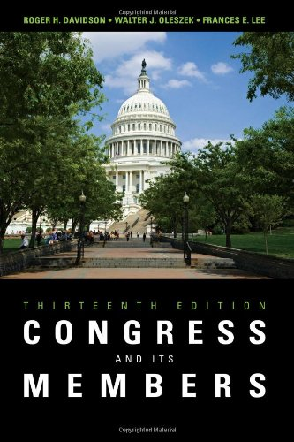
Congress and Its Members,
13th Edition
Date: July 2011
by Roger H. Davidson,
Walter J. Oleszek, and
Frances E. Lee
Washington: CQ Press.

Slide 6
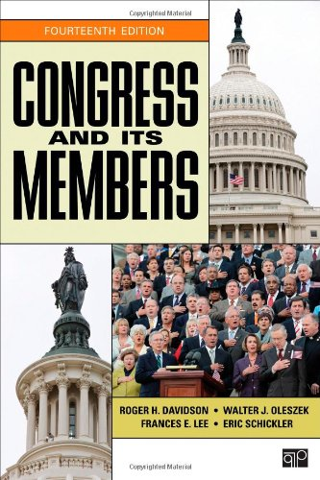
Congress and Its Members,
14th Edition
Date: July 2013
by Roger H. Davidson,
Walter J. Oleszek,
Frances E. Lee, and
Eric Schickler
Washington: CQ Press.

Slide 7
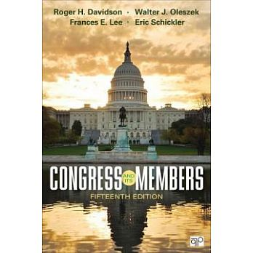
Congress and Its Members,
15th Edition
Date: July 2015
by Roger H. Davidson,
Walter J. Oleszek,
Frances E. Lee, and
Eric Schickler
Washington DC:
SAGE | CQ Press.

Slide 8
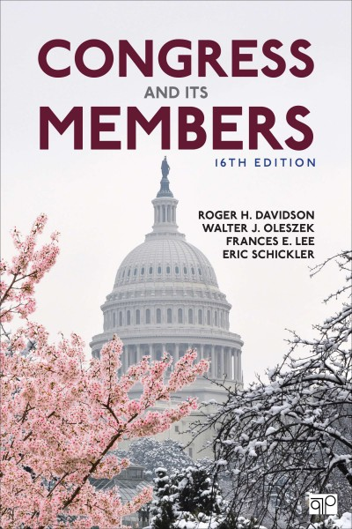
Congress and Its Members,
16th Edition
Date: June 2017
by Roger H. Davidson,
Walter J. Oleszek,
Frances E. Lee, and
Eric Schickler
Washington DC:
SAGE | CQ Press.

Slide 9
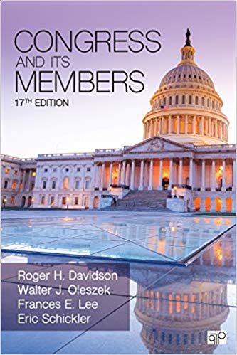
Congress and Its Members,
17th Edition
Date: July 2019
by Roger H. Davidson,
Walter J. Oleszek,
Frances E. Lee, and
Eric Schickler
Thousand Oaks CA:
SAGE | CQ Press.

Slide 10
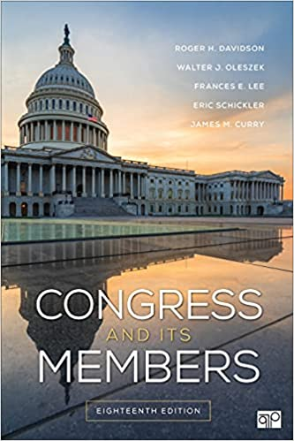
Congress and Its Members
EIGHTEENTH EDITION
September 2021
Roger H. Davidson
University of Maryland, USA
Walter J. Oleszek - Congressional Research Service , American University Washington
Frances E. Lee - Princeton University, USA
Eric Schickler - University of California-Berkeley, USA
James M. Curry - University of Utah
Washington DC:
SAGE | CQ Press

Slide 11

Roger H. Davidson Roger H. Davidson is professor emeritus of government and politics at the University of Maryland, and has served as visiting professor of political science at the University of California, Santa Barbara.
He is a Fellow of the National Academy of Public Administration. During the 2001–2002 academic year, he served as the John Marshall Chair in political science at the University of Debrecen, Hungary.
His books include Remaking Congress: Change and Stability in the 1990s, co-edited with James A. Thurber (1995), and Understanding the Presidency, Seventh Edition, co-edited with James P. Pfiffner (2012). Davidson is co-editor with Donald C. Bacon and Morton Keller of The Encyclopedia of the United States Congress (1995).
Roger H. Davidson

Slide 12
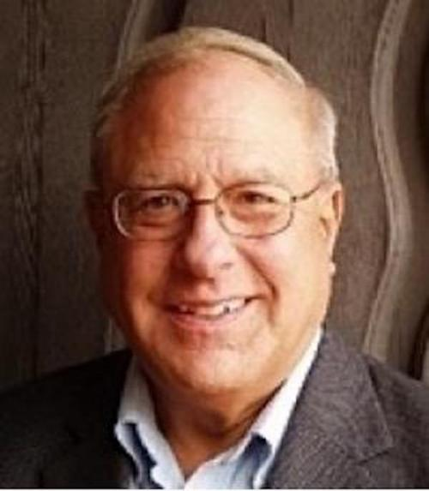
In Memoriam: Dr. Roger H. Davidson
Dr. Roger H. Davidson was professor in American politics in the Department of Government and Politics at University of Maryland from 1987 and retired and was awarded the title of Professor Emeritus in 1999. Dr. Davidson passed peacefully on April 14, 2021.

Slide 13
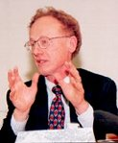
Walter J. Oleszek is a senior specialist in American national government at the Congressional Research Service.
He has served as either a full-time professional staff aide or consultant to every major House and Senate congressional reorganization effort beginning with passage of the Legislative Reorganization Act of 1970. In 1993, he served as policy director of the Joint Committee on the Organization of Congress.
A longtime adjunct faculty member at American University, Oleszek is a frequent lecturer to various academic, governmental, and business groups.
He is the author or co-author of several books, including Congressional Procedures and the Policy Process, 11th ed. (2020), and Congress under Fire: Reform Politics and the Republican Majority, with C. Lawrence Evans (1997).
Walter J. Oleszek

Slide 14
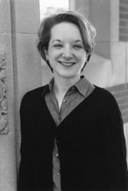
Frances E. Lee is professor of government and politics at the University of Maryland.
She has been a Research Fellow at the Brookings Institution and an APSA Congressional Fellow.
Most recently, she is the author of Insecure Majorities: Congress and the Perpetual Campaign (2016).
She is also author of Beyond Ideology: Politics, Principles, and Partisanship in the U.S. Senate (2009), which received the Richard F. Fenno Jr. Prize for the best book on legislative politics in 2010 and the D. B. Hardeman Prize for the best book on the U.S. Congress published in 2009.
She is co-author, with Bruce I. Oppenheimer, of Sizing Up the Senate: The Unequal Consequences of Equal Representation (1999).
Her articles have appeared in American Political Science Review, Journal of Politics, Legislative Studies Quarterly, and American Journal of Political Science, among others.
Frances E. Lee

Slide 15
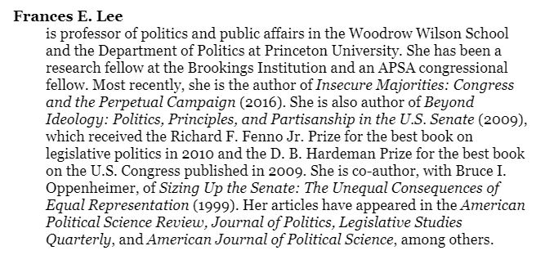

Slide 16
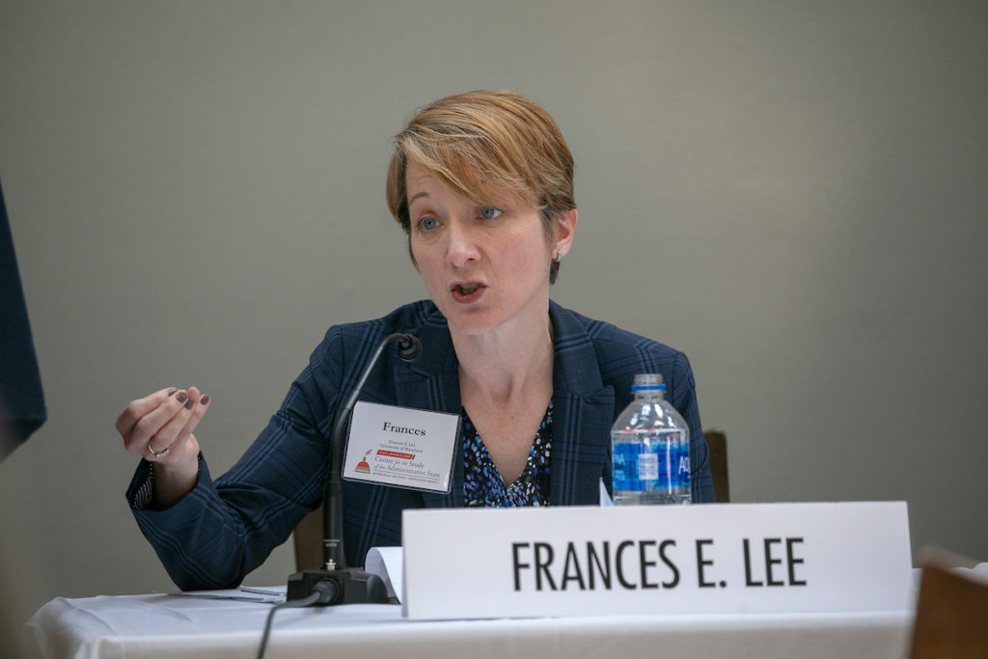
Frances Lee provides commentary during panel 2 on “How Does Central Party Control in Congress Affect the Legislative Process?” May 14, 2019

Slide 17
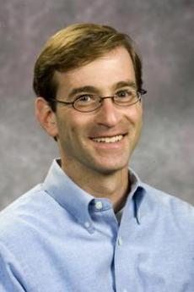
Eric Schickler is Jeffrey & Ashley McDermott Professor of Political Science at the University of California, Berkeley.
He is the author of Disjointed Pluralism: Institutional Innovation and the Development of the U.S. Congress (2001), which won the Richard F. Fenno Jr. Prize for the best book on legislative politics in 2002,
and of Racial Realignment: The Transformation of American Liberalism, 1932–1965 (2016).
He is also the co-author, with Donald Green and Bradley Palmquist, of Partisan Hearts and Minds (2002);
with Gregory Wawro, of Filibuster: Obstruction and Lawmaking in the U.S. Senate (2006), which won the Fenno Prize in 2007;
and, with Douglas Kriner, Investigating the President: Congressional Checks on Presidential Power (2016).
His articles have appeared in the American Political Science Review, American Journal of Political Science, Legislative Studies Quarterly, and Studies in American Political Development, among others.
Eric Schickler

Slide 18

James M Curry
I am an associate professor and Director of Graduate Studies in the Department of Political Science at the University of Utah.
My research focuses on U.S. politics and policymaking, especially the U.S. Congress.
I analyze how contemporary legislative processes and institutions affect legislative politics, with a particular focus on the role of parties and leaders in the U.S. Congress.
I received my Ph.D. in Government and Politics from the University of Maryland in 2011, and previously worked on Capitol Hill in the offices of Congressman Daniel Lipinski and the House Appropriations Committee.

Slide 19
10th Edition July 2005
Part I. In Search of the Two Congresses
1. The Two Congresses
2. Evolution of the Modern Congress
Part II. A Congress of Ambassadors
3. Going for It: Recruitment and Candidacy
4.Making It: The Electoral Game
5. Being There: Hill Styles and Home Styles
Part III. A Deliberative Assembly of One Nation
6. Leaders and Parties in Congress
7. Committees: Workshops of Congress
8. Congressional Rules and Procedures
9. Decision Making in Congress
Part IV. Policy Making and Change in the Two Congresses
10. Congress and the President
11. Congress and the Bureaucracy
12. Congress and the Courts
13. Congress and Organized Interests
14. Congress, Budgets, and Domestic Policy Making
15. Congress and National Security Policies
Conclusion
16. The Two Congresses and the American People

Slide 20
11th Edition August 2007
Part I. In Search of the Two Congresses
1. The Two Congresses
2. Evolution of the Modern Congress
Part II. A Congress of Ambassadors
3. Going for It: Recruitment and Candidacy
4. Making It: The Electoral Game
5. Being There: Hill Styles and Home Styles
Part III. A Deliberative Assembly of One Nation
6. Leaders and Parties in Congress
7. Committees: Workshops of Congress
8. Congressional Rules and Procedures
9. Deliberation in Congress
Part IV. Policy Making and Change in the Two Congresses
10. Congress and the President
11. Congress and the Bureaucracy
12. Congress and the Courts
13. Congress and Organized Interests
14. Congress, Budgets, and Domestic Policymaking
15. Congress and National Security Policies
Part V. Conclusion
16. The Two Congresses and the American People

Slide 21
12th Edition July 2009
    Part I. In Search of the Two Congresses
    1. The Two Congresses
    2. Evolution of the Modern Congress
    Part II. A Congress of Ambassadors
    3. Going for It: Recruitment and Candidacy
    4. Making It: The Electoral Game
    5. Being There: Hill Styles and Home Styles
    Part III. A Deliberative Assembly of One Nation
    6. Leaders and Parties in Congress
    7. Committees: Workshops of Congress
    8. Congressional Rules and Procedures
    9. Deliberation in Congress
    Part IV. Policy Making and Change in the Two Congresses
    10. Congress and the President
    11. Congress and the Bureaucracy
    12. Congress and the Courts
    13. Congress and Organized Interests
    14. Congress, Budgets, and Domestic Policymaking
    15. Congress and National Security Policies
    Part V. Conclusion
    16. The Two Congresses and the American People

Slide 22
13th Edition July 2011
Part I. In Search of the Two Congresses
1. The Two Congresses
2. Evolution of the Modern Congress
Part II. A Congress of Ambassadors
3. Going for It: Recruitment and Candidacy
4. Making It: The Electoral Game
5. Being There: Hill Styles and Home Styles
Part III. A Deliberative Assembly of One Nation
6. Leaders and Parties in Congress
7. Committees: Workshops of Congress
8. Congressional Rules and Procedures
9. Deliberation in Congress
Part IV. Policy Making and Change in the Two Congresses
10. Congress and the President
11. Congress and the Bureaucracy
12. Congress and the Courts
13. Congress and Organized Interests
14. Congress, Budgets, and Domestic Policymaking
15. Congress and National Security Policies
Part V. Conclusion
16. The Two Congresses and the American People

Slide 23
14th Edition July 2013
Part I In Search of the Two Congresses
1 The Two Congresses
2 Evolution of the Modern Congress
Part II A Congress of Ambassadors
3 Going for It: Recruitment and Candidacy
4 Making It: The Electoral Game
5 Being There: Hill Styles and Home Styles
Part III A Deliberative Assembly of One Nation
6 Leaders and Parties in Congress
7 Committees: Workshops of Congress
8 Congressional Rules and Procedures
9 Deliberation in Congress
Part IV Policy Making and Change in the Two Congresses
10 Congress and the President
11 Congress and the Bureaucracy
12 Congress and the Courts
13 Congress and Organized Interests
14 Congress, Budgets, and Domestic Policymaking
15 Congress and National Security Policies
Part V Conclusion
16 The Two Congresses and the American People

Slide 24
15th Edition July 2015
Part I In Search of the Two Congresses
1 The Two Congresses
2 Evolution of the Modern Congress
Part II A Congress of Ambassadors
3 Going for It: Recruitment and Candidacy
4 Making It: The Electoral Game
5 Being There: Hill Styles and Home Styles
Part III A Deliberative Assembly of One Nation
6 Leaders and Parties in Congress
7 Committees: Workshops of Congress
8 Congressional Rules and Procedures
9 Deliberation in Congress
Part IV Policy Making and Change in the Two Congresses
10 Congress and the President
11 Congress and the Bureaucracy
12 Congress and the Courts
13 Congress and Organized Interests
14 Congress, Budgets, and Domestic Policymaking
15 Congress and National Security Policies
Part V Conclusion
16 The Two Congresses and the American People

Slide 25
16th Edition June 2017
Part I In Search of the Two Congresses
1 The Two Congresses
2 Evolution of the Modern Congress
Part II A Congress of Ambassadors
3 Going for It: Recruitment and Candidacy
4 Making It: The Electoral Game
5 Being There: Hill Styles and Home Styles
Part III A Deliberative Assembly of One Nation
6 Leaders and Parties in Congress
7 Committees: Workshops of Congress
8 Congressional Rules and Procedures
9 Decision Making in Congress
Part IV Policy Making and Change in the Two Congresses
10 Congress and the President
11 Congress and the Bureaucracy
12 Congress and the Courts
13 Congress and Organized Interests
14 Congress, Budgets, and Domestic Policy Making
15 Congress and National-Security Policies
Part V Conclusion
16 The Two Congresses and the American People

Slide 26
17th Edition June 2019
Part I In Search of the Two Congresses
1 The Two Congresses
2 Evolution of the Modern Congress
Part II A Congress of Ambassadors
3 Going for It: Recruitment and Candidacy
4 Making It: The Electoral Game
5 Being There: Hill Styles and Home Styles
Part III A Deliberative Assembly of One Nation
6 Leaders and Parties in Congress
7 Committees: Workshops of Congress
8 Congressional Rules and Procedures
9 Decision Making in Congress
Part IV Policy Making and Change in the Two Congresses
10 Congress and the President
11 Congress and the Bureaucracy
12 Congress and the Courts
13 Congress and Organized Interests
14 Congress, Budgets, and Domestic Policy Making
15 Congress and National-Security Policies
Part V Conclusion
16 The Two Congresses and the American People

Slide 27
18th Edition September 2021
PART I. IN SEARCH OF THE TWO CONGRESSES
Chapter 1. The Two Congresses
Chapter 2. Evolution of the Modern Congress
PART II. A CONGRESS OF AMBASSADORS
Chapter 3. Going for It: Recruitment and Candidacy
Chapter 4. Making It: The Electoral Game
Chapter 5. Being There: Hill Styles and Home Styles
PART III. A DELIBERATIVE ASSEMBLY OF ONE NATION
Chapter 6. Leaders and Parties in Congress
Chapter 7. Committees: Workshops of Congress
Chapter 8. Congressional Rules and Procedures
Chapter 9. Decision Making in Congress
PART IV. POLICY MAKING AND CHANGE IN THE TWO CONGRESSES
Chapter 10. Congress and the President
Chapter 11. Congress and the Bureaucracy
Chapter 12. Congress and the Courts
Chapter 13. Congress and Organized Interests
Chapter 14. Congress, Budgets, and Domestic Policy Making
Chapter 15. Congress and National Security Policies
PART V. CONCLUSION
Chapter 16. The Two Congresses and the American People

Slide 28
主要題材
14. Congress, Budgets, and Domestic Policy Making
15. Congress and National Security Policies
8. Congressional Rules and Procedures
9. Decision Making in Congress
6. Leaders and Parties in Congress
7. Committees: Workshops of Congress

Slide 29
評分方式
1.期末考 50%
a. 5題問答，每題10分。
b. 期末考試題於第15週(12/23)線上發卷，作答後於第16週(12/30)交卷，未交卷者視同期末考缺考。
(第17週繳交學期報告，未完成者可延至第18週)

Slide 30
2.學期報告 50%
a.報告題目自訂，但須與課堂教材、講授主題相關。
b.題目訂定應先與老師口頭討論。
c.題目訂定後應自擬一簡單大綱，依題目與大綱開始搜集相關資料。資料陸續取得後，題目與大剛可能須再加修訂，此一過程反覆進行至自己認為題材均已成熟為止，即可進行撰寫。

Slide 31
d.繳交學期報告時，應另列一頁，包含書面題目、大綱，並簡述最初討論日期、資料蒐集狀況及歷次討論概要情形，以供評分。
e.報告內容可以參考各種文獻資料，但引用資料應註明資料來源，報告全文最後應列出所有參考資料(作者，文章篇名或書名[期刊名稱、卷期]，出版年)。
存取網際網路文獻資料亦須註明資料來源。
f.無論引用多少資料，報告仍須自己撰寫，至少文字表現與整體結構應為自己原創。

Slide 32
g.評分時如發現若干報告彼此雷同，必將詳細比對，如係抄襲、複製、改編他人報告而成者，成績以零分計。
h.報告篇幅：約2000字上下，長短均可。
i.報告評分項目如下：
1.口頭討論及題材發展過程
2.題目闡釋
3.文字結構及運用
4.資料運用及整體態度
5.繳交時間

Slide 33
j. 報告準備與討論過程可以小組方式進行。
報告題目(預定題材)彼此相近者可組成小組，小組成員與人數可以自行決定。
小組成員可以共同蒐集資料，交互參考。
小組成員與老師課堂討論，可集體整組進行以節省時間。
小組工作過程與歷次討論情形應做成紀錄。
但最終每位同學仍應自己提出單獨的報告，報告題目不必與小組整體完全相關。
參與小組分工與討論過程中，仍應依據自己的看法決定題目與內容方向。

Slide 34
美國國會相關網站
https://www.senate.gov/
http://www.house.gov/
https://www.congress.gov/

Slide 35
CNN
http://us.cnn.com/
http://edition.cnn.com/ELECTION/2020/results/president/
http://us.cnn.com/politics
http://transcripts.cnn.com/TRANSCRIPTS/
http://edition.cnn.com/POLITICS/
http://us.cnn.com/specials/politics/congress-capitol-hill

